Slide 1




Hotel Management System
DEPI Graduation Project 2024
Instructor: Kerolos Yousef
DotPy Company

Slide 2




Team and Roles
Ahmed
Ayman
Asem
Emad
Adham Osama
Zeyad Abdelaziz
Abdallah Mohamed
Database Creation
Power BI
ETL
ETL
ETL
ETL

Slide 3
Agenda
Overview
KPIs
Project Steps
Visualization

Slide 4
Overview
ERD Mapping
Intro
Report

Slide 5

Overview
What’s our project ?
Stakeholders
What’s the benefit ?

Slide 6
KPIs
ERD Mapping
Intro
Report

Slide 7
KPIs
Total Revenue per Hotel
Average Room Occupancy Rate
Staff Salary Cost per Hotel
Average Payment per Guest
Guest Retention Rate

Slide 8
Project Steps
ERD Mapping
Intro
Report

Slide 9
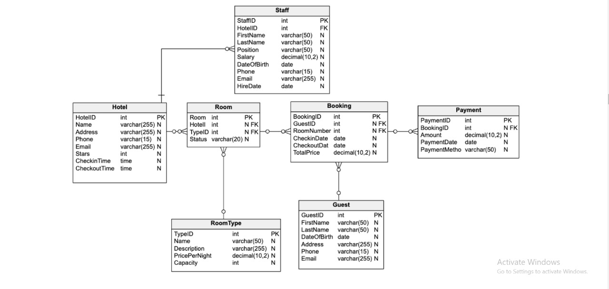
Step One (ERD)

Slide 10
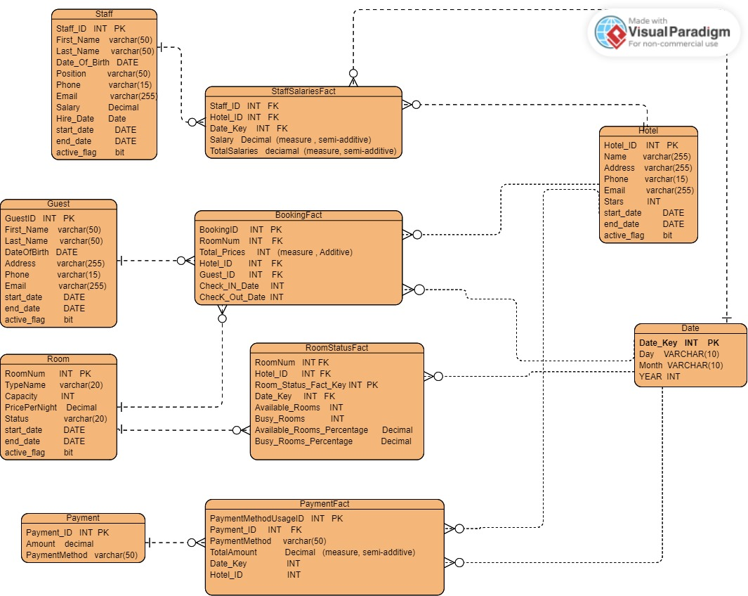
Step Two (Star Schema)

Slide 11
Step Three (ETL)
Extract
Transform
Load

Slide 12
Extract
ERD Mapping
Intro
Report

Slide 13
Transform
ERD Mapping
Intro
Report

Slide 14
Load
ERD Mapping
Intro
Report

Slide 15


Visualization

Slide 16
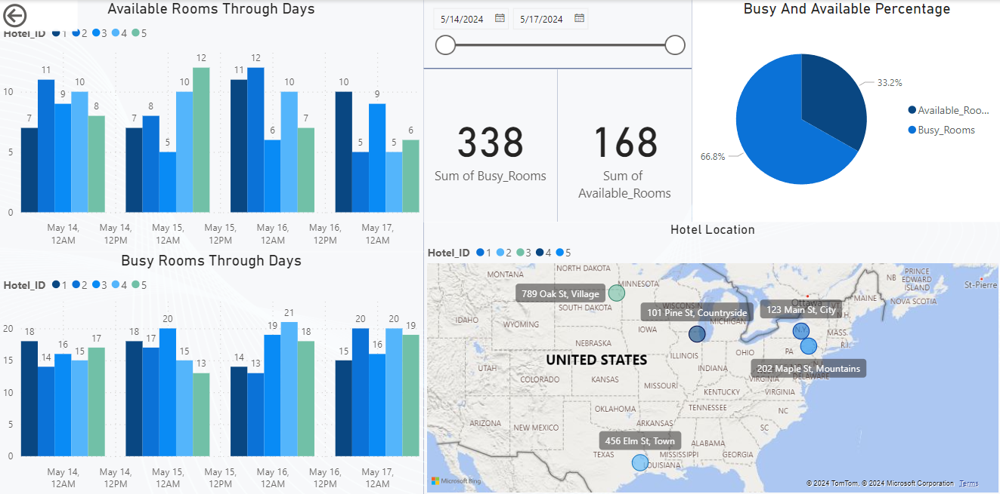
Hotel Dashboard

Slide 17
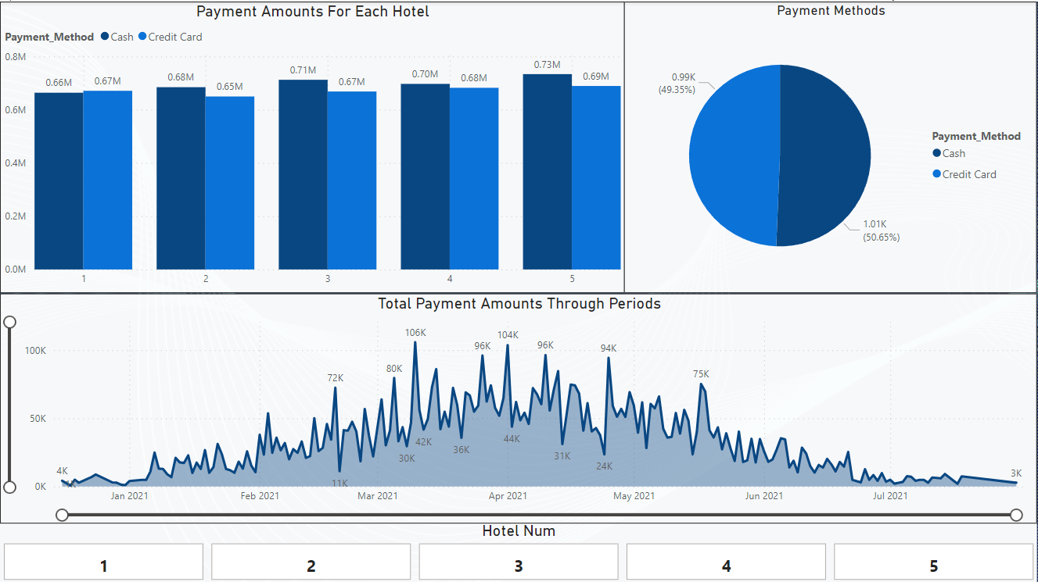
Paymant Dashboard

Slide 18
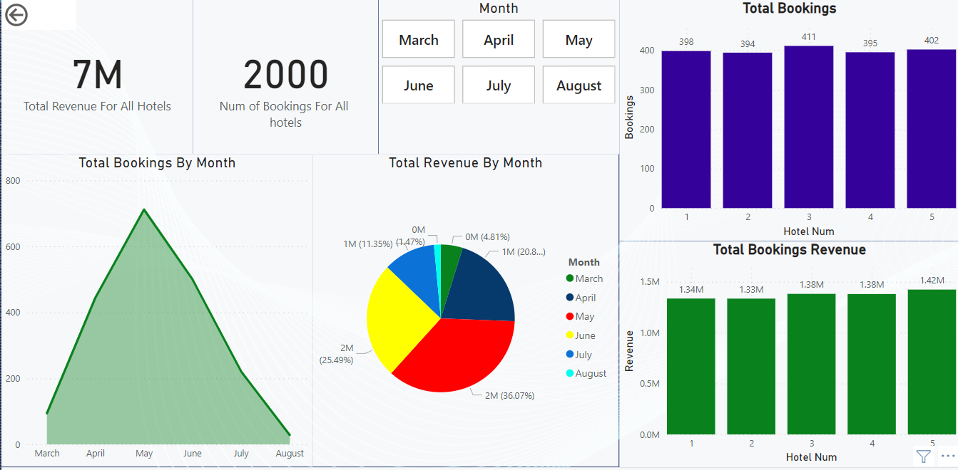
Booking Dashboard

Slide 19
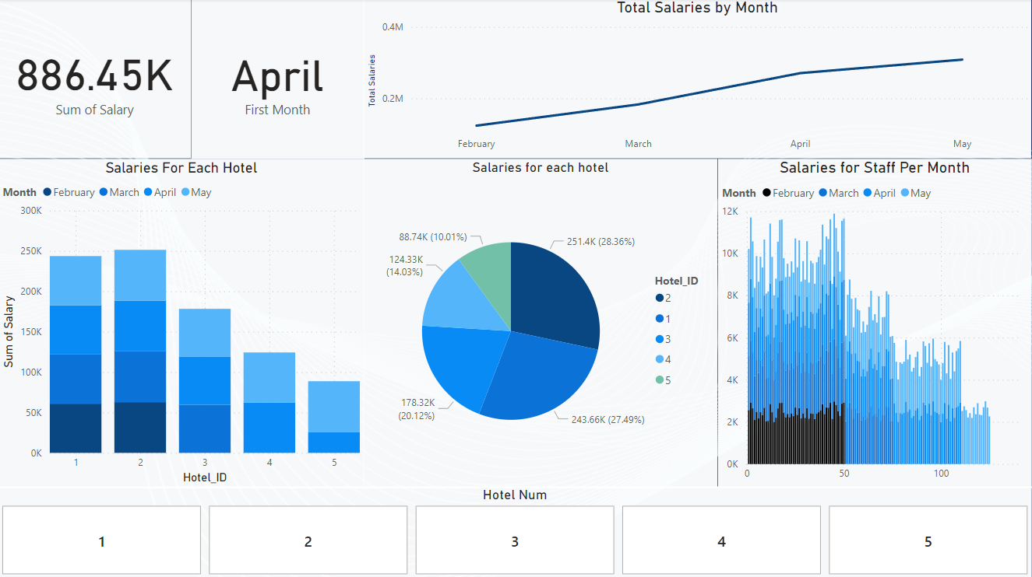
Staff Salaries Dashboard

Slide 20

THANK YOU!

